Slide 1
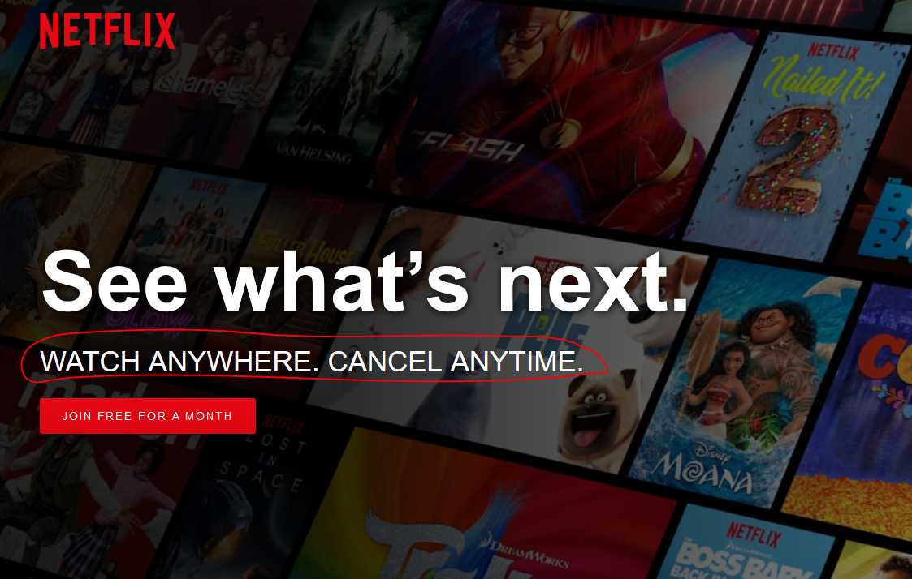
PROJECT OWNER: JULIE KUMARI

Slide 2


INTRODUCTION
KPI/OBJECTIVES
INSIGHTS
1
2
3
4
CONCLUSION

Slide 3

1
INTRODUCTION
Netflix Originals: Beyond Bingeworthy
Cracking the Netflix Code: Exploring the Anatomy of Hit Original Films
Unlocking the secrets of successful Netflix originals. Analyzing genre, runtime, ratings, and language to predict hits and captivate audiences, expanding market share and dominating the OTT scene. Dive in with us and discover the formula for Netflix gold!

Slide 4

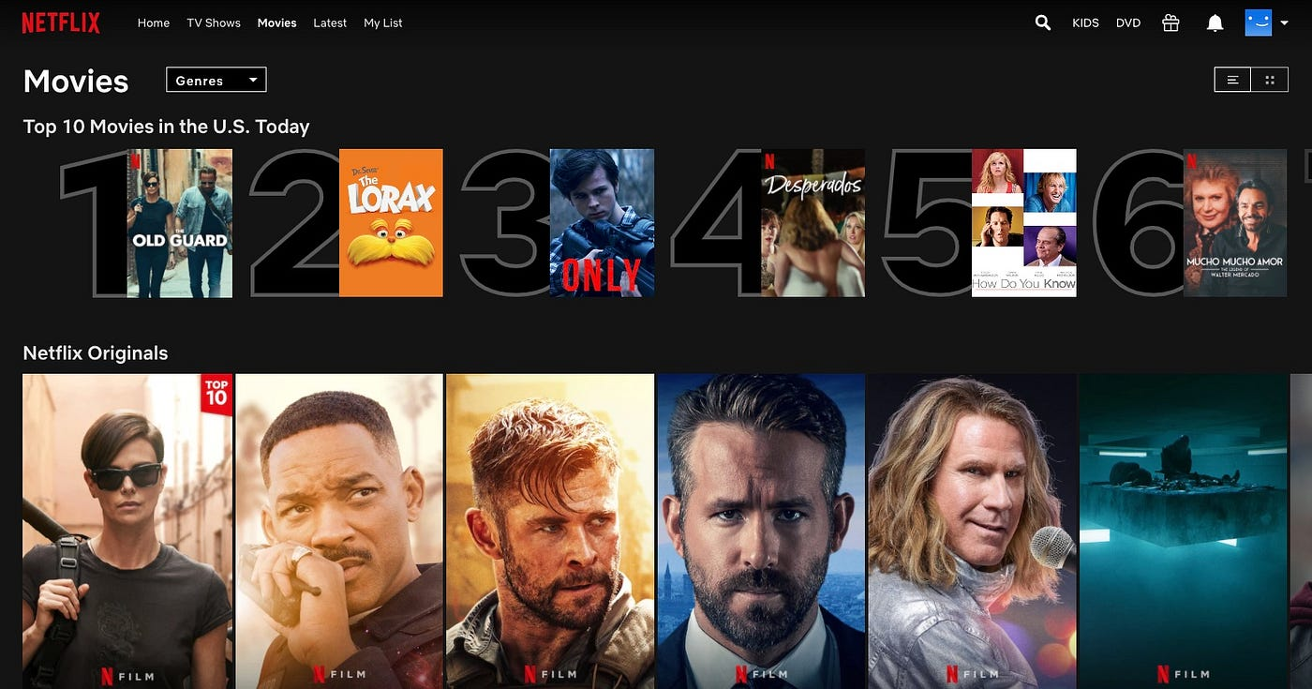
2
KPI/OBJECTIVEs
What is the average IMDB score for each genre?
Which genre has the highest average runtime?
Are longer movies rated higher on IMDB?
What is the distribution of movies across different languages?
What is the trend in the number of releases over the years?
Which year had the highest average IMDB score?
Are movies in certain languages rated higher on average?
What is the distribution of IMDB scores?
What is the most common genre on Netflix?
What is the average runtime of movies released in different months?

Slide 5
3
INSIGHTS
Which genre has the highest average runtime?
What is the average IMDB score for each genre?

Slide 6

Are longer movies rated higher on IMDB?
What is the distribution of movies across different languages?

Slide 7

What is the trend in the number of releases over the years?
Which year had the highest average IMDB score?

Slide 8
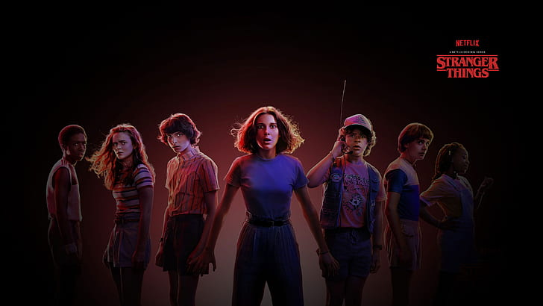
Are movies in certain languages rated higher on average?
What is the distribution of IMDB scores?

Slide 9

What is the average runtime of movies released in different months?
What is the most common genre on Netflix?

Slide 10
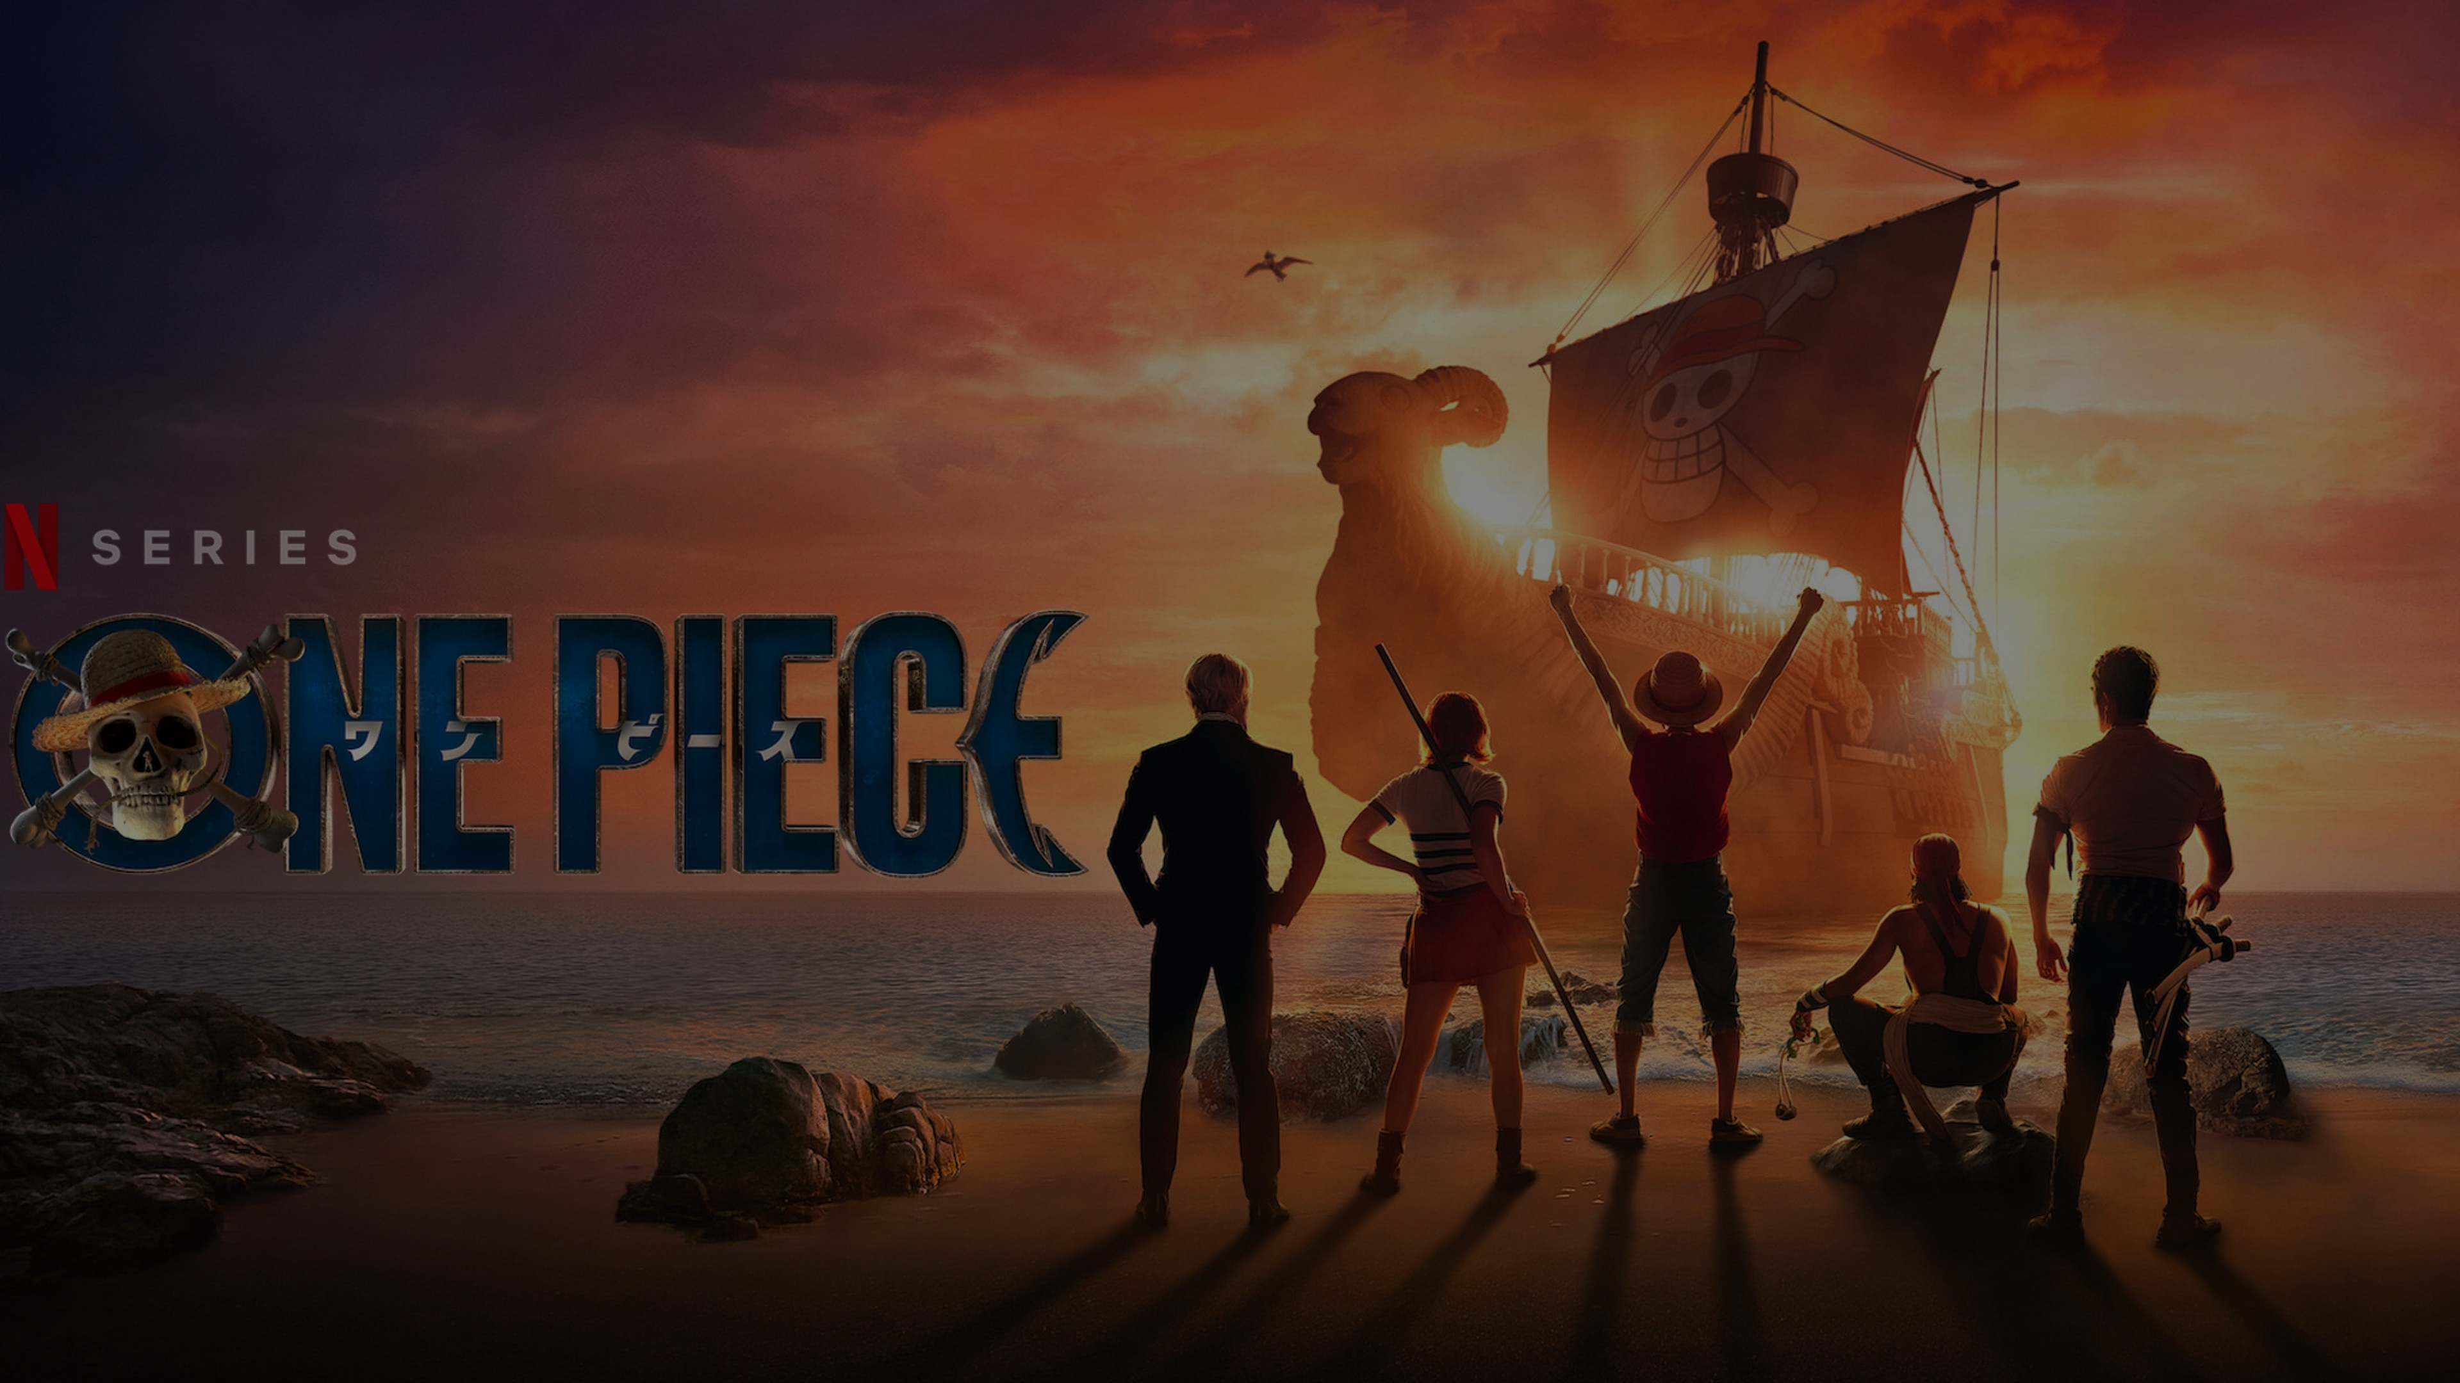
CONCLUSION
Beyond binge-worthy: We dissected the captivating world of Netflix Originals, using a comprehensive data analysis to uncover hidden gems. Our goal? Not only to understand what makes these films popular but also to prepare this data for future machine learning models. By pinpointing the defining features of successful content, we aim to equip Netflix with the knowledge to craft even more captivating experiences, expanding their reach and solidifying their position in the ever-evolving OTT landscape.

Slide 11
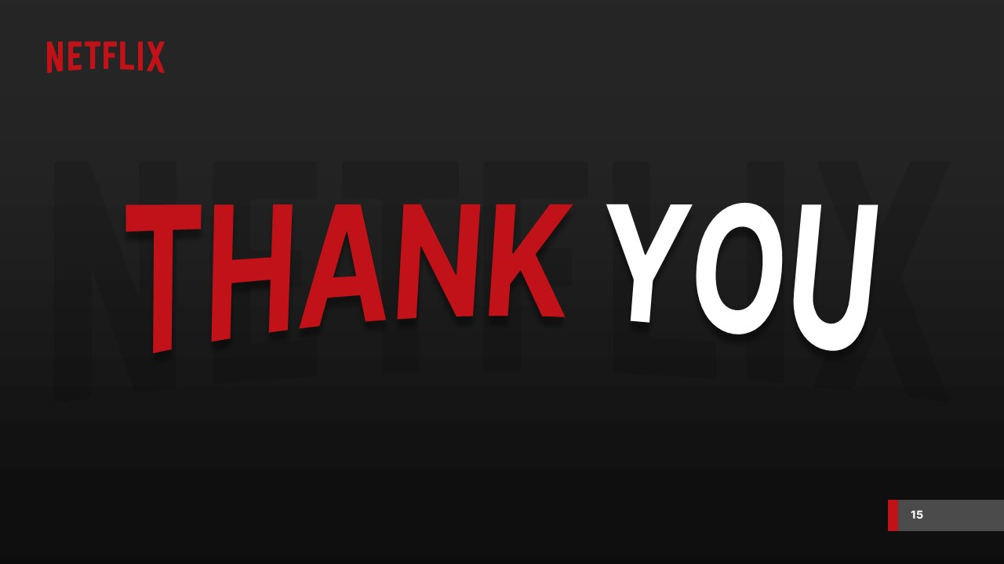






Connect with me for any concern or query
_julie_03_
https://peerlist.io/_julie_

